Slide 1
SPINE
Schools Project to Increase Employability in the European Equestrian market
Business plan and management

Slide 2


Slide 3
planning
Chapter | subject | module
About yourself | Introduction Mission and vission USP concept | M1
Goals | Strategy S.M.A.R.T. | M1
SWOT-analysis | Strenghts, Weaknesses, Oppurtunities and Threats | M1
Marketing Mix | Product, Price, Place and Promotion | M1
Finance | Liquidity balance Operating budget Liquidity budget | M2
Presentation |  | M3

Slide 4
Introduction
Introduction business plan
Who are you?
Why do you write this plan?
How did you came up with the idea?
How will you futher develop the idea?

Slide 5
Mission and Vision
Mission: what am I here for?
Vision: where do I want to go?
A good Mission and Vision are:
Ambitious or even idealistic
Motivating or even commiting
Distinctive
Relevant and guiding for stakeholders
Real, balanced and simple

Slide 6

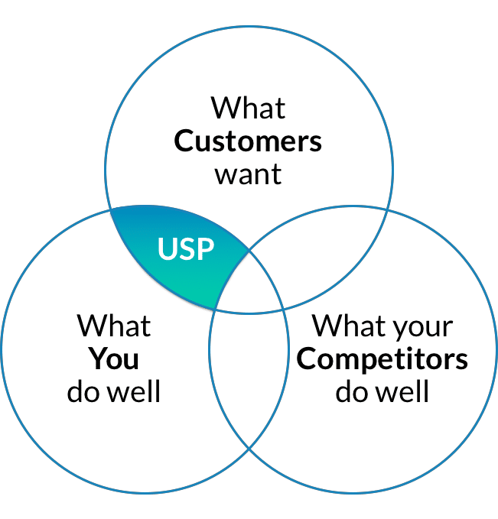
Concept
What is your USP?

Slide 7

Strategy
Mission/vision ➔
Strategic goals ➔
Tactical goals ➔
Executive goals.

Slide 8
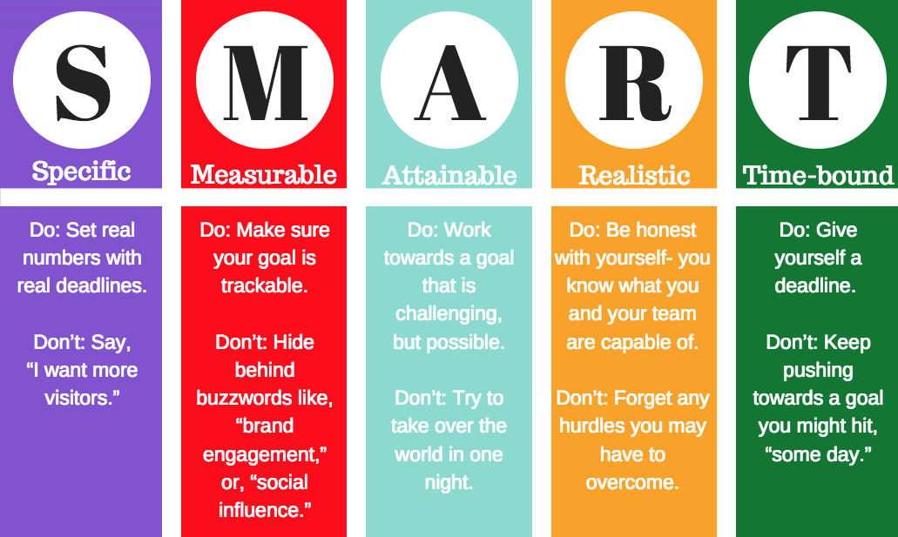
S.M.A.R.T.

Slide 9
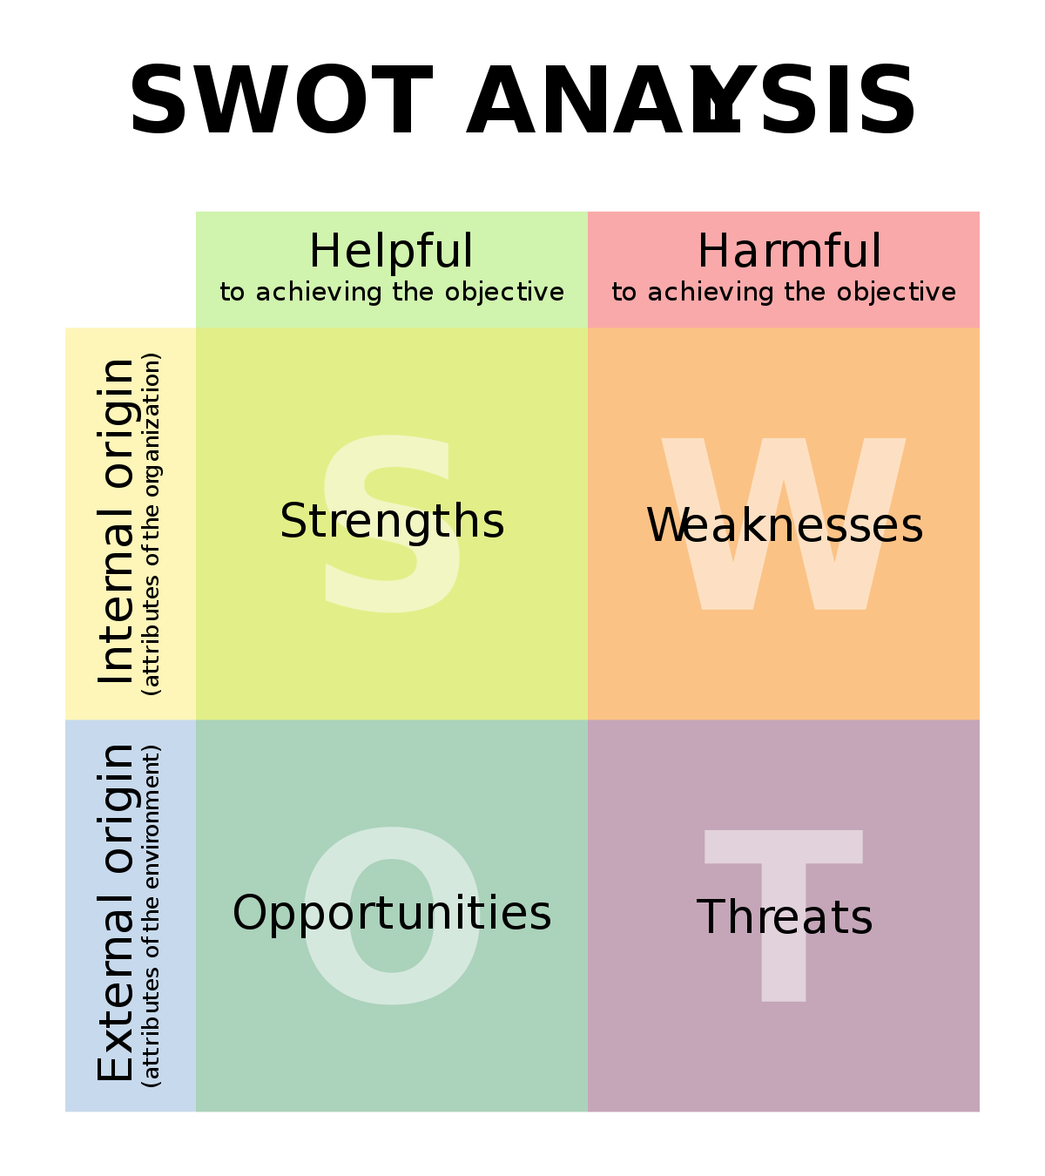

Slide 10
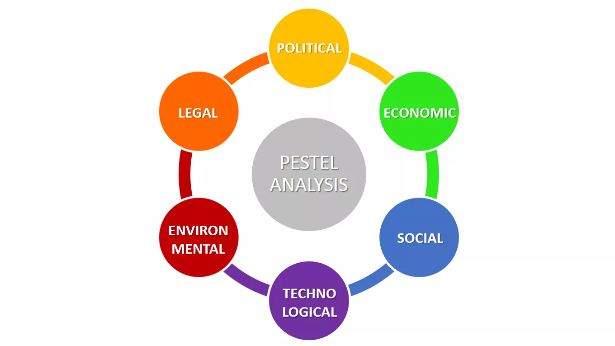
Opportunities & Threats

Slide 11
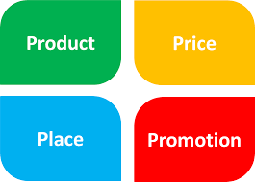




Marketing Mix (4P’s)

Slide 12
Liquidity Balance
Date
Assets | Laibilities
 | Equity
Fixed assets | Longterm liabilities
Current assets | Shortterm liabilities

Slide 13
Operating budget
Determine: revenues, sales, turnover, earnings and income. How many customers will you have? What will be your fee? Per day? Per assignment? | 2. Determine: expenses, costs What costs do you have to make to obtain your income? What extra costs do you have to make? For example: pay extra personel while you are abroad to give a clinic.

Slide 16

Liquidity budget
The liquidity budget is an overview of expected receipts and expense in a given period.

Slide 17
Differences between operating budget en liquidity budget
Operating budget | Liquidity budget
Depreciations Amounts excl VAT | Repayments Amounts incl VAT takes into account the period in which amounts are actually received or paid.

Slide 18
Questions???

Slide 19

THANK YOU FOR YOUR ATTENTION!
This work is licensed under a Creative Commons Attribution-ShareAlike 4.0 International License. The texts produced in the Extra Qualification by the partners of the SPINE project are freely accessible through open license.

