Slide 1
SPINE
Schools Project to Increase Employability in the European Equestrian market
The Rider as an athlete

Slide 2
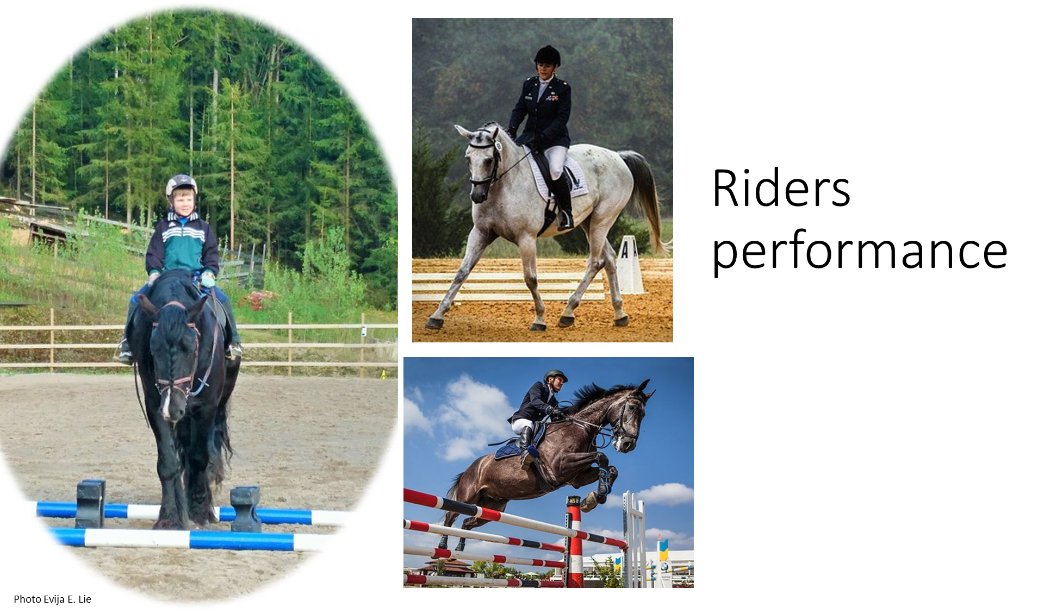

Slide 3
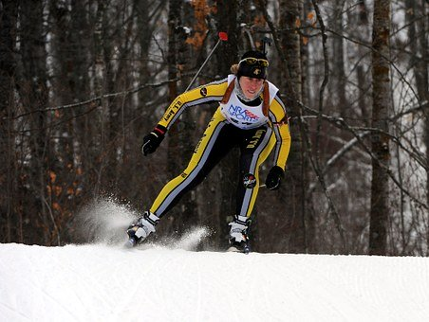
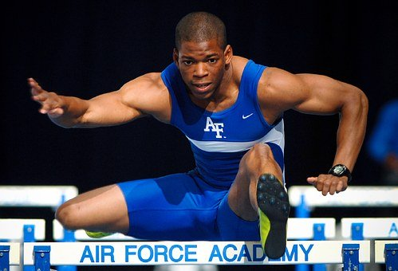
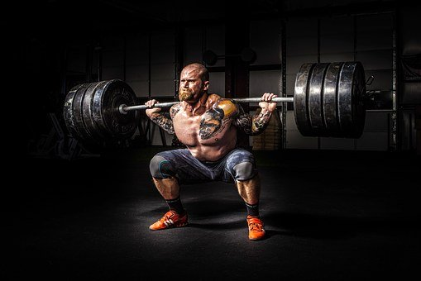
The rider as an athlete.?!

Slide 4
Knowledge, skills, learning outcome
How riders balance, mobility, strength and stamina affect her/his riding
How exercise, rest and diet affect performance
Most common rider`s injuries and how to prevent them
Are able to choose appropriate exercises to enhance balance, strength and stamina and other components of fitness to develop their riding skills.
Are able to increase riders awareness of their abilities to develop riding skills through training basic tasks.
Know how to combine different types of training of the riders seat and position and physical training to develop the quality of the rider
Knowledge how to make the rider aware of importance of education, training and diet for the performance, endurance and longevity
Theory and techniques of basic sports psychology
Knows how to create attitude which makes riders aware of their role as athletes, in cooperation with riders and candidates of other nations
Knows how to exchange knowledge and viewpoints with other sports, to promote and enhance good practices regarding the training of a rider

Slide 5
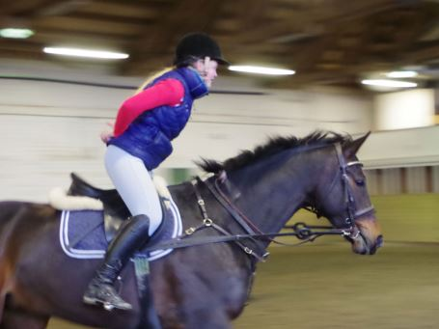
Technique spesefic training

Slide 6
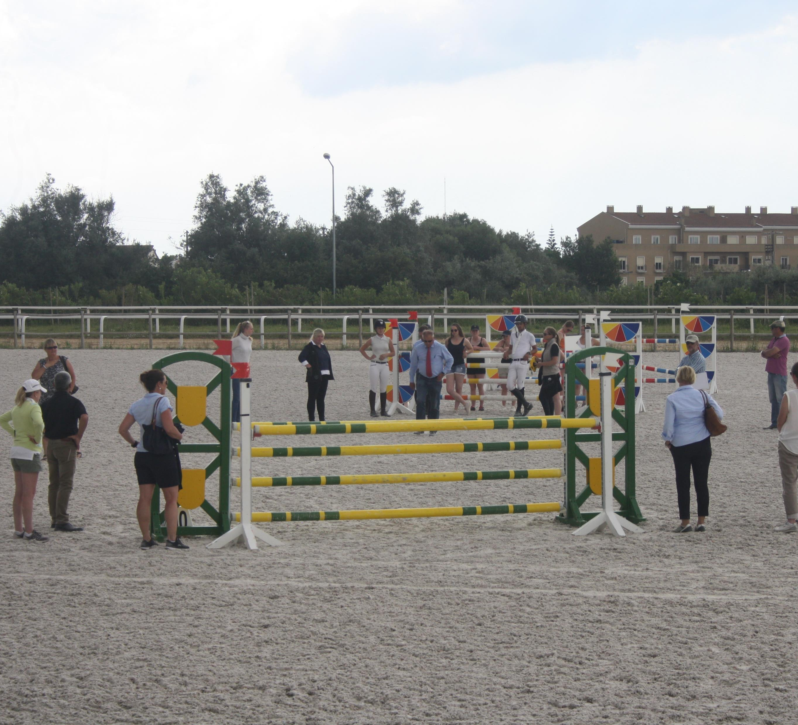
Tactics

Slide 7
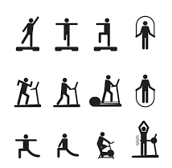
Basic training

Slide 8
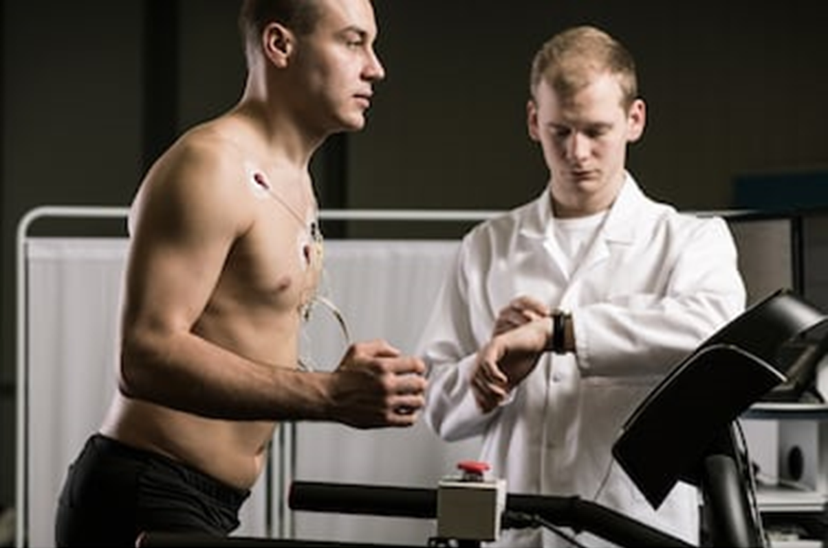
Requirements analysis

Slide 9
Warm-up

Slide 10


Stamina

Slide 11
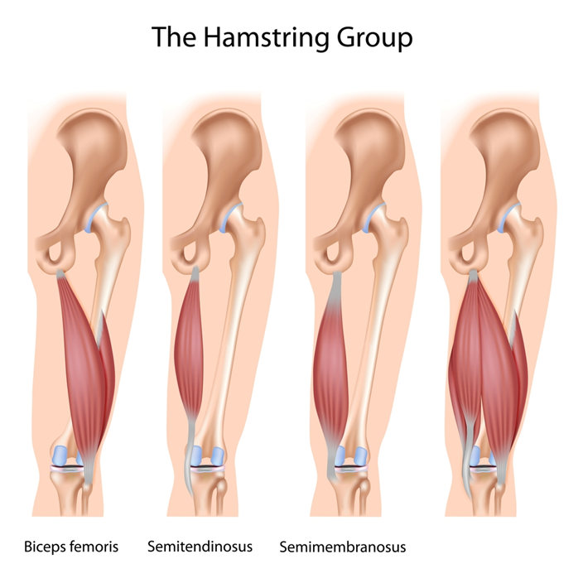
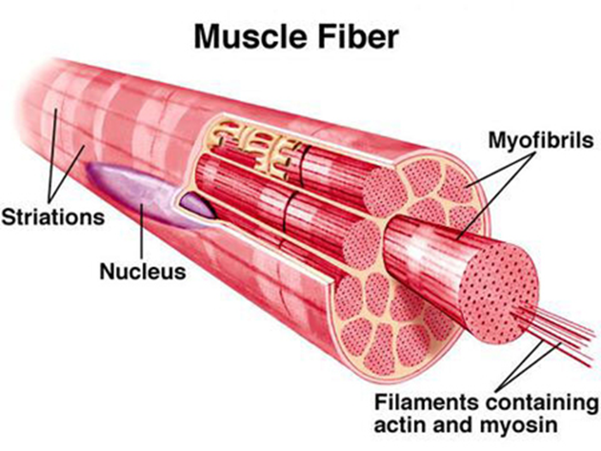
Strength
Bilde av en muskel

Slide 12
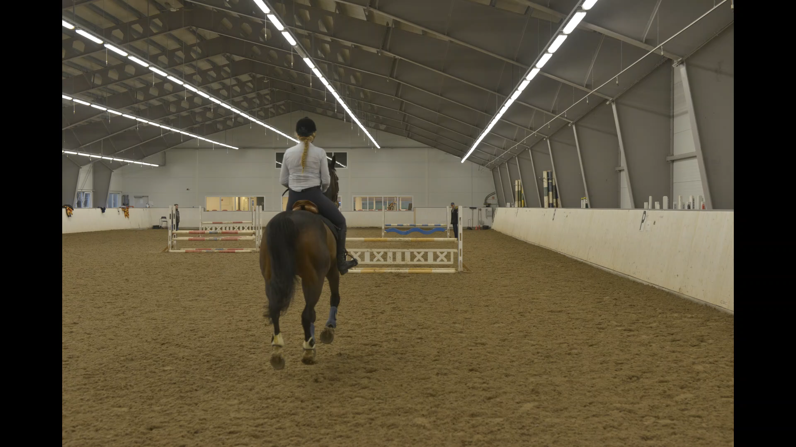
Mobility

Slide 13
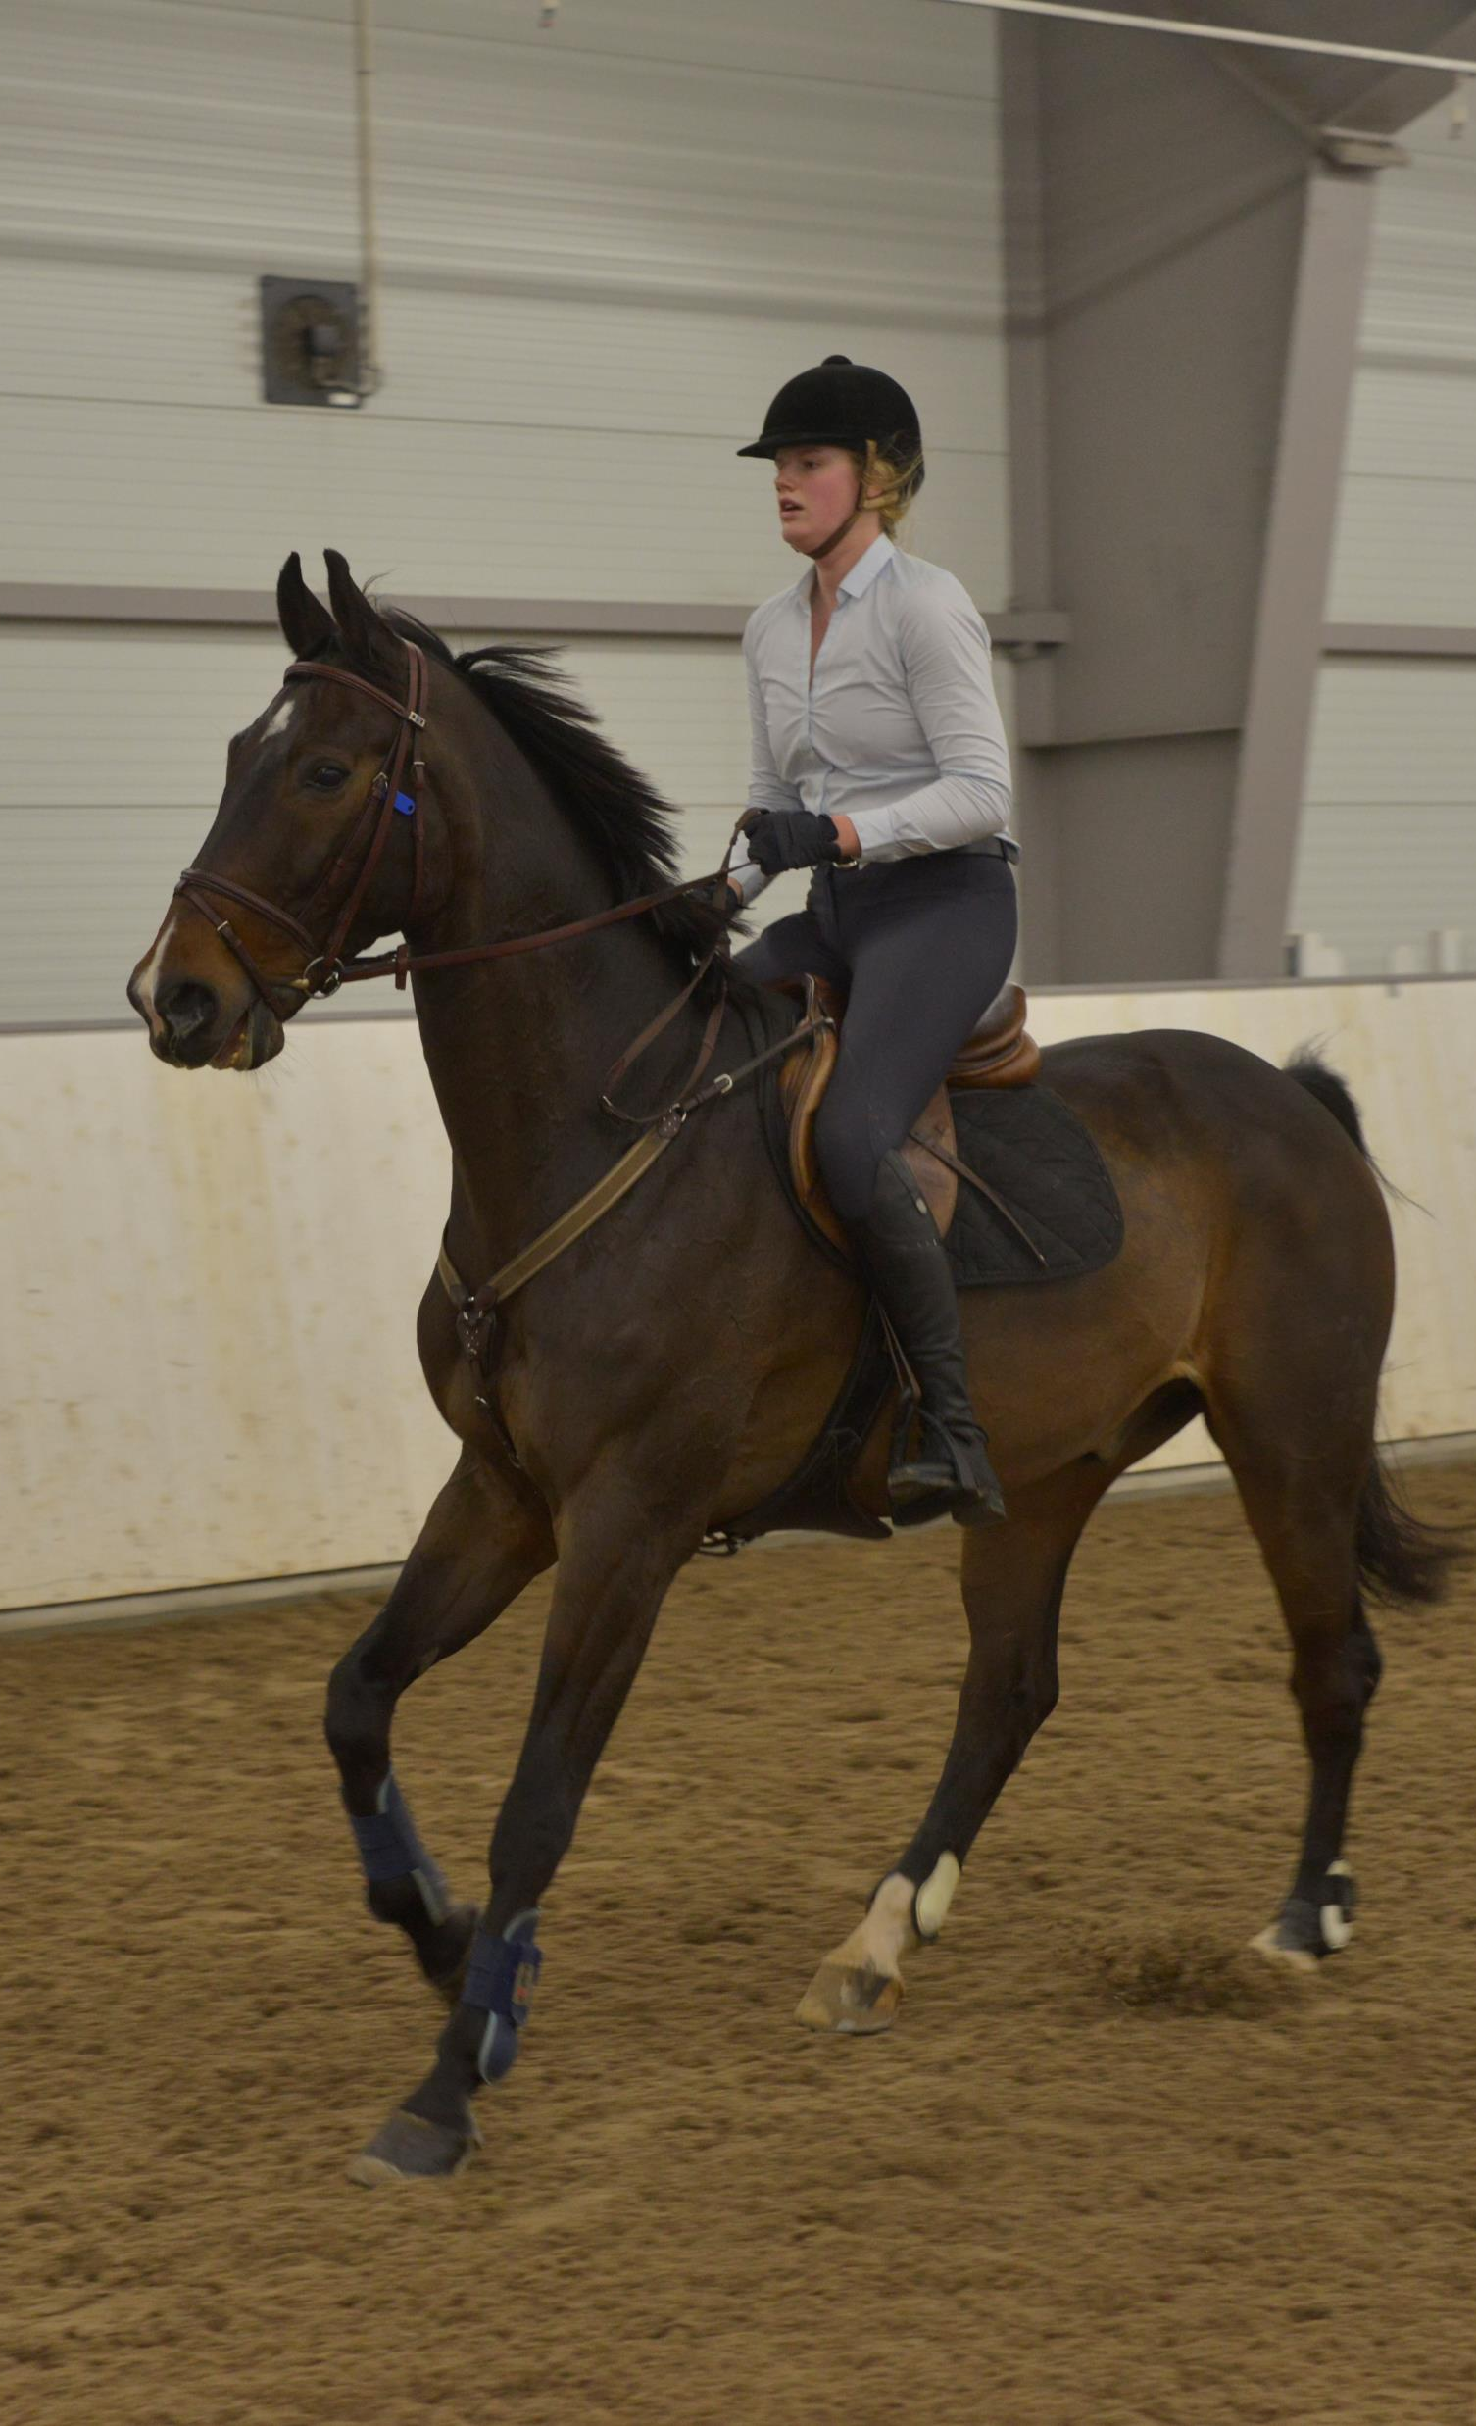
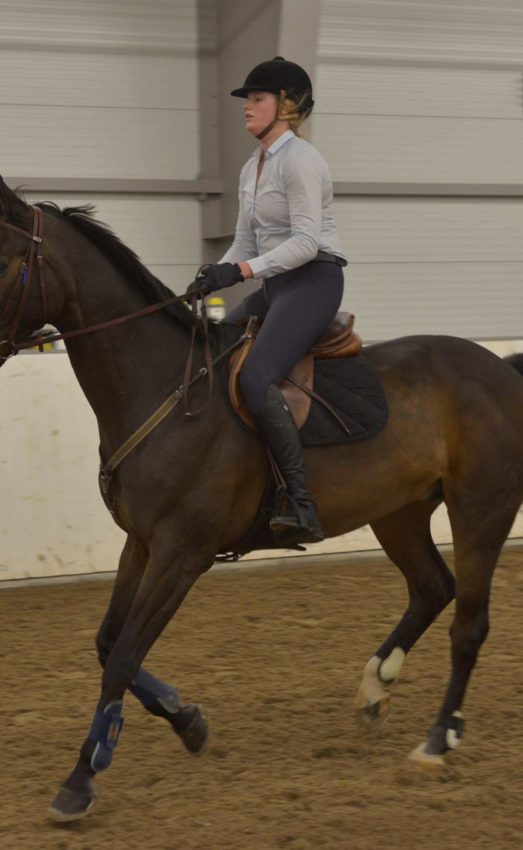
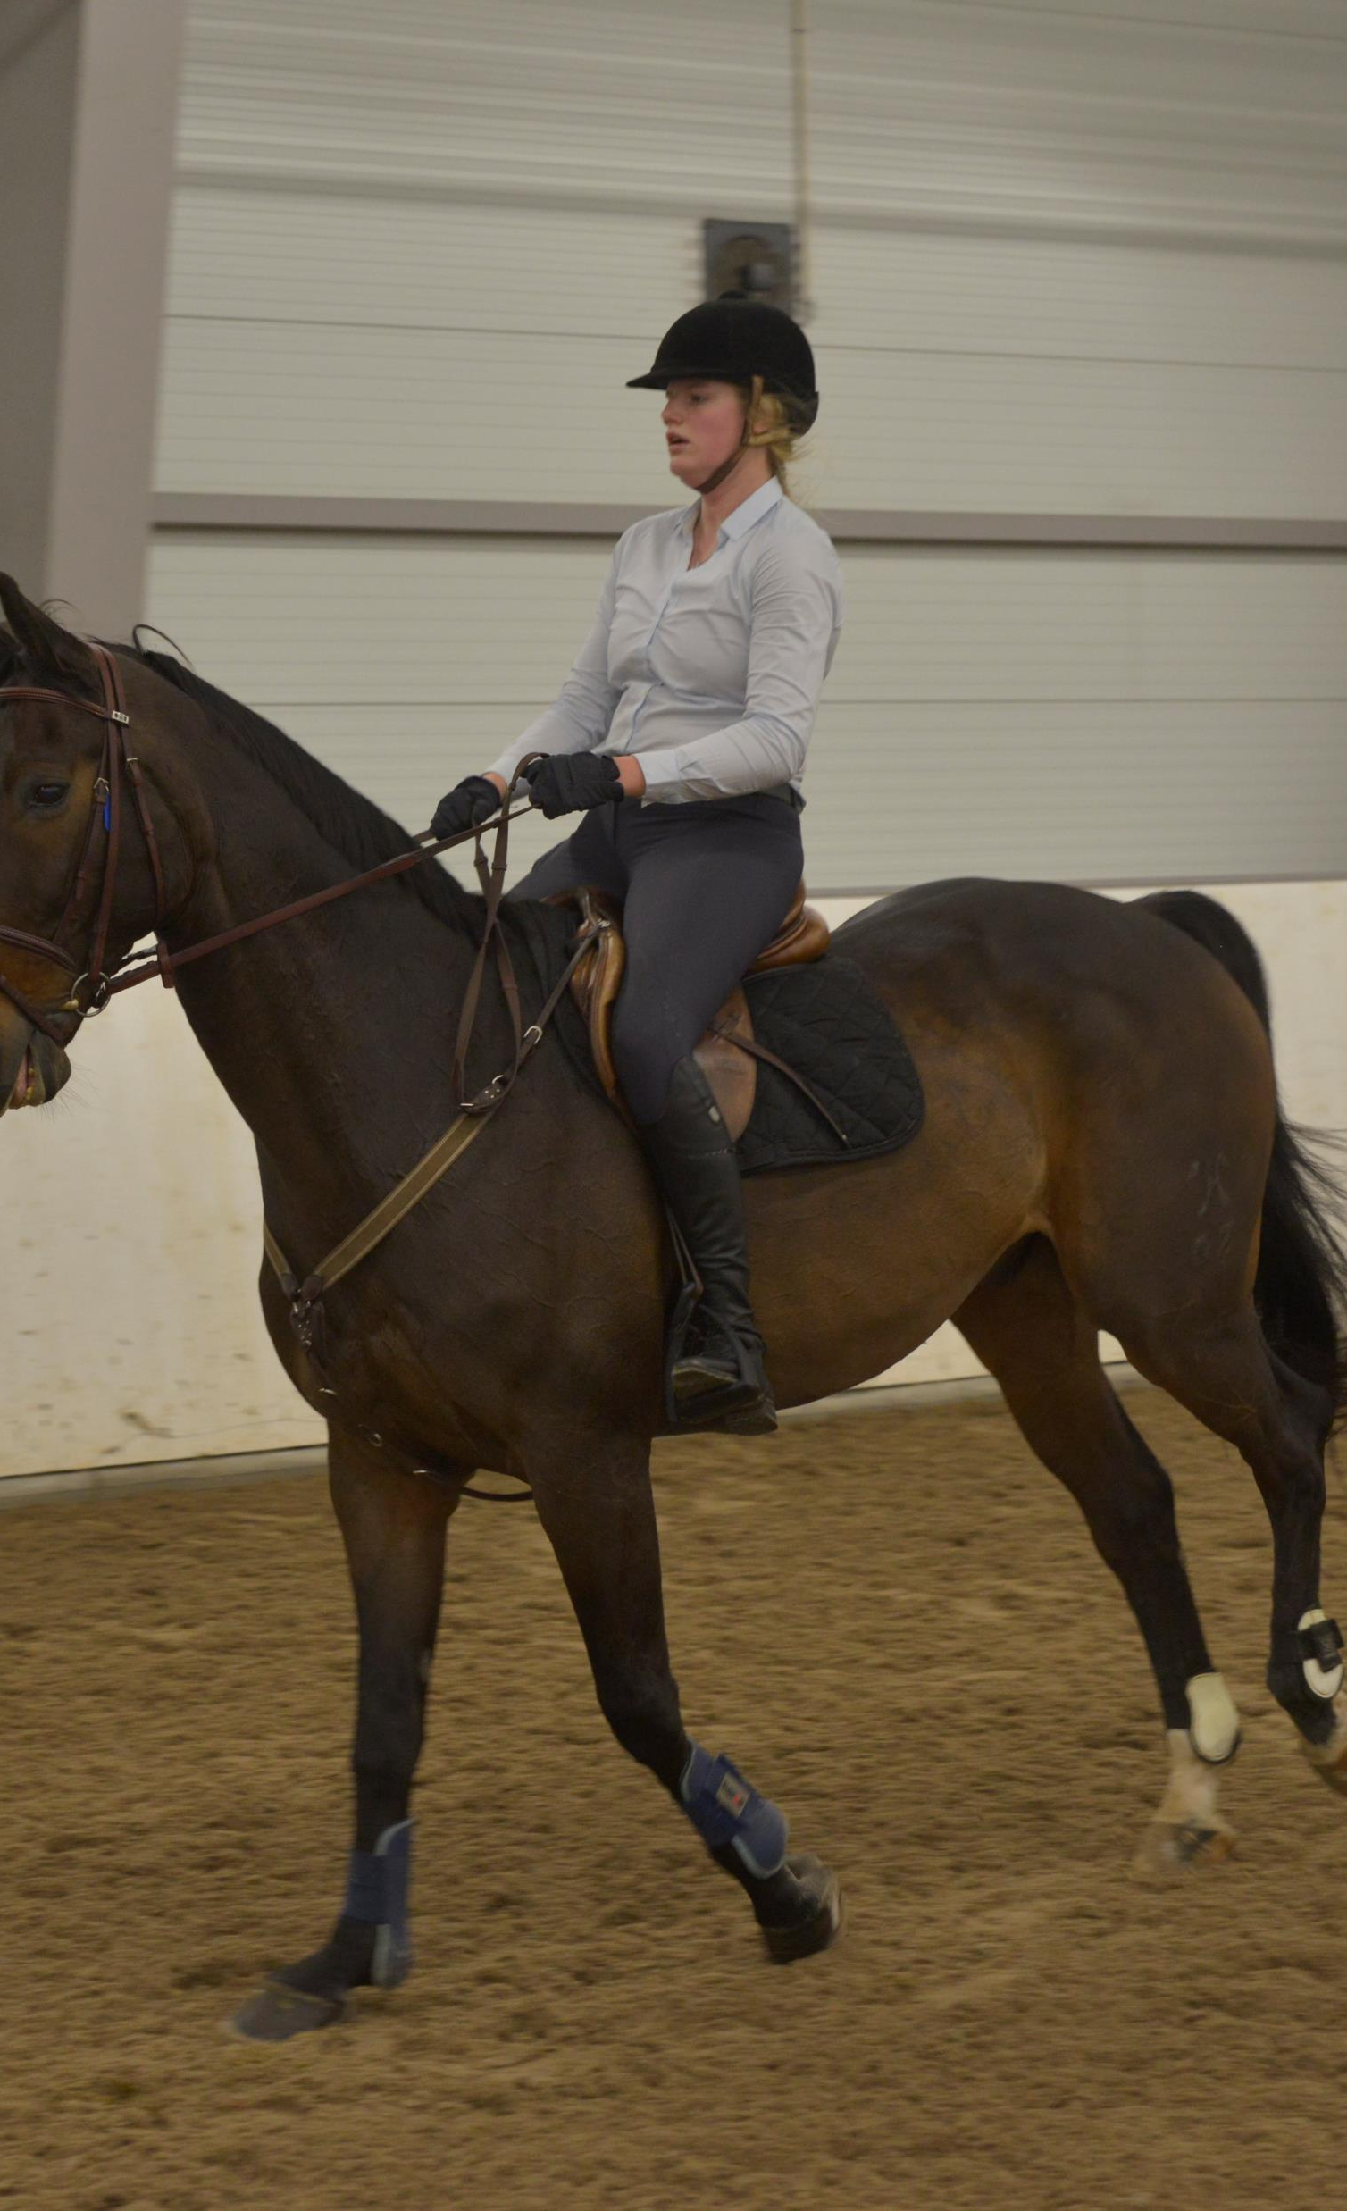

Slide 14

Suspention

Slide 15
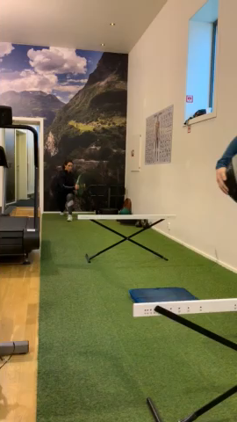
Coordination/reaction

Slide 16
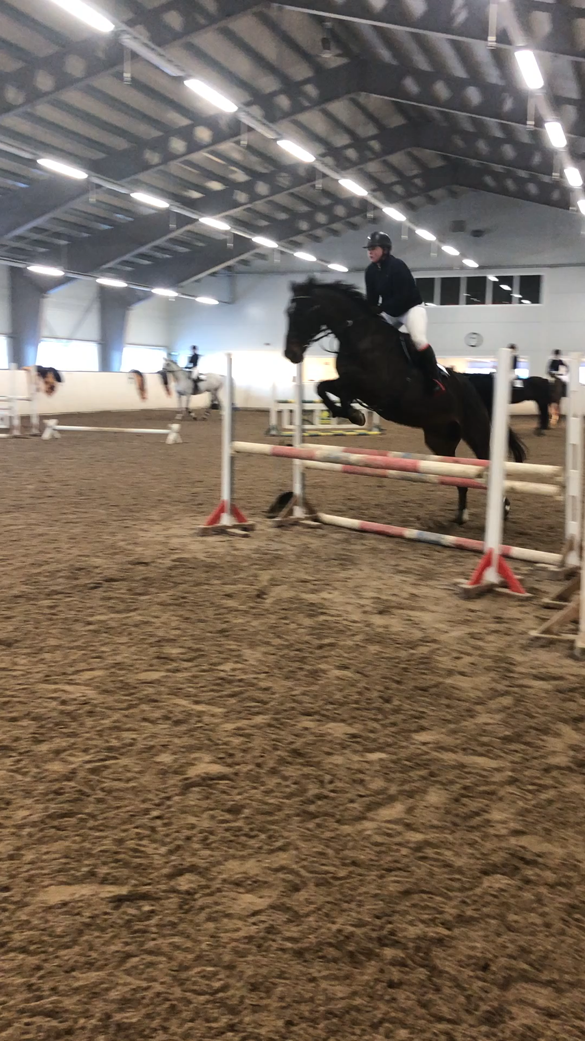
What can You recommend to this rider?

Slide 17
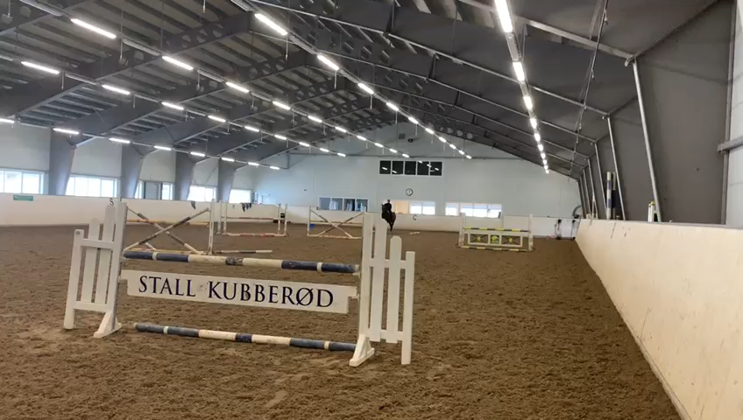
2,5 month later

Slide 18

So the question again:
Are we abel to change the attitude?

Slide 19
References
Treningslære, idrettsfag. Gjerset mfl. Gyldemdal forlag 2012. ISBN: 9788205419292
Level 1 students at NHS winter 2018
Advanced in Functional Training, Training Techniques for coaches, personal trainers and athletes. Michael Boyle. On Target Publicationas, Santa Cruz, California. 2010 ISBN: 978-1-931046-01-5
This work is licensed under a Creative Commons Attribution-ShareAlike 4.0 International License. The texts produced in the Extra Qualification by the partners of the SPINE project are freely accessible through open license.

