Slide 1
SPINE
Schools Project to Increase Employability in the European Equestrian market
Methodology and didactics

Slide 2
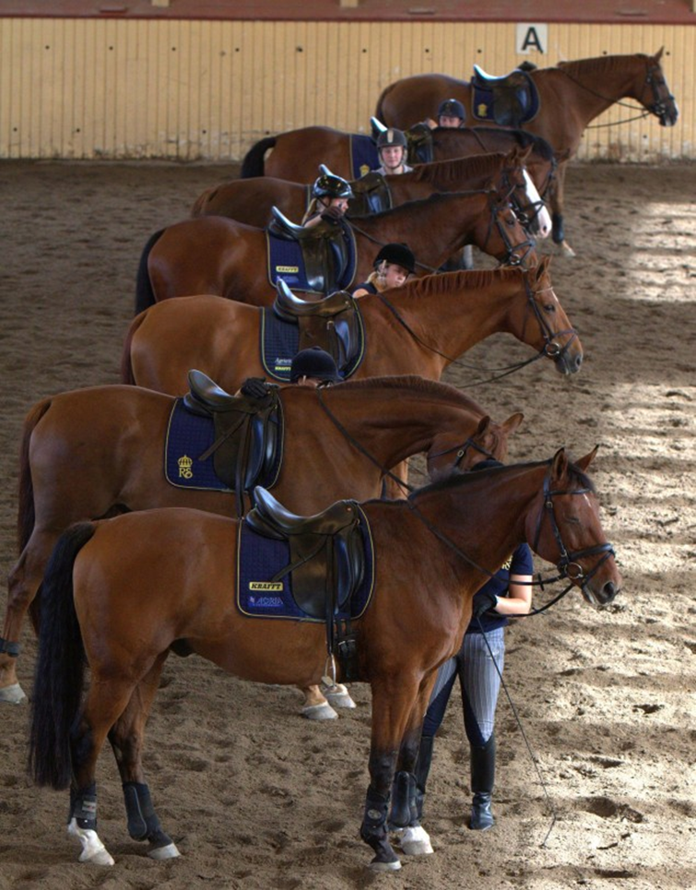
Pro Memoria – lesson plans

Slide 3
Course/exercise
DATE and TIME:
PLACE:
INSTRUCTOR:
TOPIC:
GOAL for the lession
GROUP
EQUIPMENT:

Slide 4
LESSION Time |  | The tecnic of riding. Things to observe (how to build up the riding) | Remember (time, safety, tempo, where to stand)
Introduction Presentation and goalsetting
Main exercise What? Why? How? Show Instruction Practice
Termination Spin down Feedback

Slide 5
Reflection and Analyze
This work is licensed under a Creative Commons Attribution-ShareAlike 4.0 International License. The texts produced in the Extra Qualification by the partners of the SPINE project are freely accessible through open license.

