Slide 1
Laws and Regulations

Slide 2
Questions you should ask yourself
Am I allowed to work there as a riding instructor?
What are the qualifications and certifications I need?
Do I need to have a visa in my passport or I just need to have my national identification card?
Do I need a special authorisation to work in that country for a short period? (*)

Slide 3
Questions you should ask yourself
How can I be legally paid for my work? Do I have to give my employer some kind of quittance document?
Do I need any special vaccinations?

Slide 4
Questions you should ask yourself
Are there significant differences between that country and my country on behaviour when dealing with animals that may imply horse welfare treatment?

Slide 5
Questions you should ask yourself
What are the cultural costumes in the country or region where I’m going to work? Do I have to be aware of how I behave or the clothes I must wear? And how can it influence my activity?

Slide 6
Laws and Regulations Module Structure
Module 1 –presentation and discussion
Module 2 –presentation and discussion
Module 3 –students presentations

Slide 7
Laws and Regulations Module Structure
Each student must choose a country to work in.
Based on the information given on this discipline, each student must search all the needed requirements to work in the chosen country.
Each student must make a 15 min presentation of the obtained information in Module 3, Examination.

Slide 8
European Qualifications Framework (EQF)

Slide 9
European Qualifications Framework (EQF)
Aims to relate different countries' national qualifications systems to a common European reference framework. (*)

Slide 10
European Qualifications Framework (EQF)
To be able to use the EQF to better understand and compare the qualifications levels of different countries and different education and training systems.

Slide 11
European Qualifications Framework (EQF)
So, all Member States should have their own National Qualifications Framework (NQF) based on learning outcomes.
Once the EQF is fully implemented, a German person's certificate will bear a reference to an EQF reference level.
That means that a Portuguese enterprise can use the EQF reference to get a better idea of how the German qualification compares to Portuguese qualifications.

Slide 12
European Qualifications Framework (EQF)
Do you know what is your level of qualification in your country?
Can you compare it to the qualification level in the country you intend to work?

Slide 13
Riding Instructor Qualificacions and Certifications

Slide 14
International Equestrian Federation

Slide 15
Qualifications / Certifications on Equitation
International Equestrian Federation – FEI
International Sport Coaching Framework:
Is an attempt to fill that void and to establish a current, shared coaching reference point covering the areas:

Slide 16
Qualifications / Certifications on Equitation
International Equestrian Federation – FEI
International Sport Coaching Framework:
Roles and responsibilities assumed by coaches and the tools they need in order to fulfill them.
Coaching certification and the development of more relevant qualifications.
Developments in coaching that meet the needs of athletes and sporting organisations.
Information to guide decisions on policy and legislation regarding coaching.

Slide 17
Qualifications / Certifications on Equitation
International Equestrian Federation – FEI
The FEI coaching system was created to help developing NFs to organize their own coaching structure. The system uses an agreed syllabus and helps to develop the NF's sport using local coaches.
The coaches receive a Certificate of Attendance following their participation in a Course for Coaches.

Slide 18
Qualifications / Certifications on Equitation
International Equestrian Federation – FEI
Consists on Levels 1, 2 and 3 Olympic Disciplines.
The aim of the Level 3 Course for Coaches is to cover the essential areas necessary to train to compete independently national Individuals & Teams at international 2** competition level (PSG in Dressage)..

Slide 19
Qualifications / Certifications on Equitation
International Equestrian Federation – FEI
“The certificates delivered at Level 1, Level 2 and Level 3 recognise professional competences but are not qualified Diploma”.

Slide 20
European Equestrian Federation

Slide 21
Qualifications / Certifications on Equitation
European Equestrian Federation – EEF
Was created in 2009 to fill in the need to improve the quality of communication between European National Federations.

Slide 22
Qualifications / Certifications on Equitation
European Equestrian Federation – EEF
Promoting the values and contribution of equestrianism, encouraging and PROVIDING EDUCATION based on a foundation of fair, safe competition and the welfare of its human and equine athletes by working together with all independent member bodies for the development of the sport, throughout Europe.

Slide 23
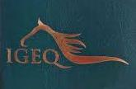
International Group for Equestrian Qualifications

Slide 24
Qualifications / Certifications on Equitation
International Group for Equestrian Qualifications - IGEQ
IGEQ Mission Statement:
To improve horse welfare by developing, promoting and maintaining equestrian qualifications standards“
Better Teaching = Better Riding = Better Horse Care = Happy Healthy, Horses!

Slide 25
Qualifications / Certifications on Equitation
International Group for Equestrian Qualifications - IGEQ
Is an independent voluntary organization of national equestrian federations (NFs) worldwide, which has compared and harmonized equestrian instructor qualifications, producing an agreed matrix of minimum requirements at 3 international levels for 6 disciplines.

Slide 26
Qualifications / Certifications on Equitation
International Group for equestrian Qualifications - IGEQ
An Equestrian Passport is available for instructors of riding, driving, vaulting, western, tourism and therapeutic.

Slide 27
Qualifications / Certifications on Equitation
International Group for equestrian Qualifications - IGEQ
The passport confirms and recognizes the holders' qualifications, enabling recognition and acceptance in IGEQ member countries. (*)

Slide 28
Qualifications / Certifications on Equitation
International Group for Equestrian Qualifications - IGEQ
In some countries qualifications and licenses are issued by a Ministry of Sport, not the National Federation. Any passport holder intending or planning to move to another country is strongly advised to contact the Federation in their chosen new country to check whether they will be eligible for a license to teach BEFORE they make firm arrangements or moves.

Slide 29
European Horse Network

Slide 30
European Horse Network
The European Horse Network is a non-profit network of stakeholders acting at a World, European, National or Regional level within the European horse, pony, donkey and welfare sector.

Slide 31
European Horse Network
Its purpose is to:
Promote the development of the horse, pony and donkey sector in Europe.
To assist members of the European Horse Welfare and the transport, slaughter and veterinarians network.
To help members coordinate their activities in order to increase the visibility and impact of the equine sport, tourism and recreation sectors.

Slide 32
European Horse Network
Act as a platform for the horse, pony and donkey industry to communicate common issues with European institutions and media at the European level.
Exchange views on political developments affecting the horse sector in Europe.
Discuss, define and lobby on areas of common interests on the European political agenda.
Discuss and define issues of common interest to develop the horse sector in Europe.

Slide 33
National Federations
Each country has its own federation (or federations) which, in conection with the IGEQ, or the FEI (or other organisations) provides qualification and certification for riding instructors.

Slide 34
National Federations, the Portuguese example:
Inicial requirements
Education
Qualification
Level Minimum 18 years old
Level 3 of the EQF
Specific examinations
Have a place to make the training post
Conducting elementary technical activities, under the supervision of superior trainers or assisting training and competition on the subsequent stages
Level 1

Slide 35
National Federations, the Portuguese example:
Inicial requirements
Education
Qualification
1 year of Professional experience as Level 1 Trainer
12 hours /Year of education
Level 3 of the EQF
To be a level 1 trainer
Training by himself or assisting trainers of superior level.
Coordinate and supervise level 1 and 2 technical training teams.
Level 2

Slide 36
National Federations, the Portuguese example:
Inicial requirements
Education
Qualification
2 years of Professional experience as Level 2 Trainer
15 hours /Year of education
Level 3 of the EQF
To be a level 2 trainer
Be able to plan exercises and evaluate the performance of level 1, 2 and 3. Coordinate and supervise different training and competition activities, specially on high performance athletes.
Level 3

Slide 37
National Federations, the Portuguese example:
Inicial requirements
Education
Qualification
3 years of Professional experience as Level 3 Trainer
20 hours /Year of education
Coordinate, direct, plan and evaluate all the training and competition activities. Innovation, direction, and selection tasks.
Level 3 of the EQF
To be a level 3 trainer
Level 4
25 hours/ Year of education to renew the Certification, after 5 years of activity

Slide 38
National Federations, the Portuguese example:
 | Level 1 | Level 2 | Level 3 | Level 4
Common formation | 40h | 60h | 90h | ? h
Specific formation | 40h | 170h | ? h | ? h
Training post | 600h | 800h | ? h | ? h
Total | 680h | 1030h | ? h | ? h

Slide 39
International and national tax rules
A Value Added Tax Identification Number or VAT identification number (VATIN) is an identifier used in many countries, including the countries of the European Union, for value added tax purposes.

Slide 40
How can I be rewarded in a different country?
To be rewarded in Portugal you need to:

Slide 41
To work in Portugal you need to:
Ask for a VAT number to the Fiscal Authorities on the Web Site (http://www.portaldasfinancas.gov.pt/at/html/index.html).
So, you must deliver, at this web site, a XML-Schema file, according to the proper instructions.

Slide 42
To work in Portugal you need to:
To work on a XML-Schema file you must have a proper application, like the XML Spy.
You can get these applications at www.w3c.org/XML/Schema.
You can consult a User Guide at Apoio ao Contribuinte Trocas de Informação Internacionais FATCA - Foreign Account Tax Compliance Act , which is in English.

Slide 43
To work in Portugal you need to:
Then, every time you are rewarded by your employer, you must do a quittance document at the Fiscal Authorities web site, using your new VAT number. (*)

Slide 44
Animal Welfare
What are the International and National Organisations concerned with Animal Welfare, producing Recommendations, Guidelines, Laws or Regulations?

Slide 45
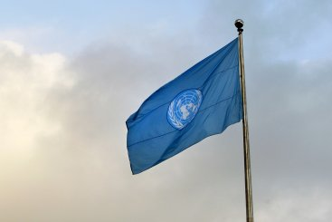
Animal Welfare
United Nations Organization – ONU

Slide 46
Animal Welfare
About animal, the ONU has worked on:
the United Nations Convention on International Trade in Endangered Species of Wild Fauna and Flora (CITES);
The United Nations Environmental Program (UNEP);
and the Environmental Assembly (UNEA).

Slide 47
Animal Welfare
Universal Declaration on Animal Welfare – UDAW

Slide 48
Animal Welfare
It is a proposed inter-governmental agreement to recognize that animals are sentient, to prevent cruelty and reduce suffering, and to promote standards on the welfare of animals such as farm animals, companion animals, animals in scientific research, wildlife and animals in recreation.

Slide 49
Animal Welfare
It is proposed that a UDAW be adopted by the United Nations.
If endorsed by the UN (as the Universal Declaration of Human Rights was) the UDAW would be a non-binding set of principles that acknowledges the importance of the sentience of animals and human responsibilities towards them.

Slide 50
Animal Welfare
The principles were designed to encourage and enable national governments to introduce and improve animal protection legislation and initiatives.

Slide 51
Animal Welfare
The Declaration of Animal Rights

Slide 52
Animal Welfare
It is a project of international animal rights and planet conservation group.
Our Planet. Theirs Too - was drafted in May 2011 and publicly read and signed on June 3rd of the same year, on the 1st National Animal Rights Day in the US, in the city of New York.

Slide 53
Animal Welfare
The Declaration was copied onto a large scroll of paper, which since then has been traveling the world and collecting people's signatures, drawings and notes. It is now 100 meters long, with almost 15,000 signatures.

Slide 54
Animal Welfare
“Once it reaches 50,000 signatures, the scroll will be sent to the White House, the UN, The EU Parliament and other world leaders, in order to show them what we, the citizens of this world, think of our fellow animals and their rights”.

Slide 55
Animal Welfare
“We will do this until The Declaration of Animal Rights is recognized all over the world, and the rights proclaimed in it are protected by global law!”

Slide 56
Animal Welfare
World Animal Net - WAN

Slide 57
Animal Welfare
It is an NGO in consultative status with the Economic and Social Council (ECOSOC) at the United Nations.

Slide 58
Animal Welfare
It actively engages with world leaders at the highest levels to raise awareness on significant animal protection matters.

Slide 59
Animal Welfare
European Commission

Slide 60
Animal Welfare
The key priorities of the Commission is to promote an enhanced dialogue on animal welfare issues that are relevant at EU level among competent authorities, businesses, civil society and scientists.

Slide 61
Animal Welfare
EU strategy on animal welfare:
Improving welfare standards
Making sure that these standards are applied and enforced in all European Union countries.

Slide 62
Animal Welfare
It operates under the guiding principle 'Everyone is responsible‘
EU countries are responsible for:
Day to day enforcement through their national legislation and control activities;
Transposition of directives into national legislation and the implementation of EU rules at national level.

Slide 63
Animal Welfare
The Portuguese rules for transport

Slide 64
Animal Welfare
It is considered that the European regulations for animal transport are not applied to the transport that is not for economic purpose.
So, it is acceptable that equestrian sport is not an economic activity.

Slide 65
Animal Welfare
So, to transport a horse, according to the paragraph 1, of the 8º article of the Directrix 90/426/CEE, the horse must have:
Identification document, according to the (CE) 504/2008 Regulation.
A Certificate from the National Veterinary Control (DGV), model number 132/DGV, valid for 10 days.
The driver must have a certification for animal transport, that is achieved after making a special course (25 hours).

Slide 66
Animal Welfare
It is not necessary to use the TRACES (Trade Control and Expert System).
Any way, it has been really confused in all European countries to understand the need or not of this system while transporting horses, and Portugal is not an exception.

Slide 67
Animal Welfare
World Organization for Animal Health – OIE

Slide 68
Animal Welfare
The OIE is the intergovernmental organisation responsible for improving animal health worldwide.
It is recognised as a reference organisation by the World Trade Organization (WTO) and in 2017 had a total of 181 Member Countries.

Slide 69
Animal Welfare
The organization is placed under the authority and control of a World Assembly of Delegates consisting of Delegates designated by the Governments of all Member Countries.

Slide 70
Animal Welfare
OIE is managed at the Headquarters situated in Paris and its financial resources are backed up by voluntary contributions from Member Countries.

Slide 71
Animal Welfare
International Fund for Animal Welfare

Slide 72
Animal Welfare
IFAW supports the implementation of international agreements in part through effective enforcement of wildlife regulations, training of anti-poaching rangers, customs agents and wildlife law enforcement officers.

Slide 73
Animal Welfare
FEI Code of Conduct for the Welfare of the Horse

Slide 74
Animal Welfare
The FEI requires all those involved in international equestrian sport to adhere to the FEI Code of Conduct and to acknowledge and accept that at all times the welfare of the Horse must be paramount.
Welfare of the horse must never be subordinated to competitive or commercial influences.

Slide 75
Animal Welfare
The following points must be particularly adhered to:
1. General Welfare
2. Fitness to compete
3. Events must not prejudice Horse welfare
4. Humane treatment of horses
5. Education

Slide 76
Animal Welfare
The new legal statute for animals in Portugal

Slide 77
Animal Welfare
All animals are no longer considered as things, but admitted as living beens with feelings, having now a new legal statute.

Slide 78
Animal Welfare
Animals are not considered as things, but they can be still property of someone;
This claim of property does not give the owner the rigth to the to provoque pain, suffering, bat treatments, abadonement or death.

Slide 79
Animal Welfare
In case of divorce, animals must be given to one or both owners, considering the concern of all the family members and the welfare of the animal in question;
In case of a contentious divorce, the judge will decide to whom the animal will be conferred to.

Slide 80
Animal Welfare
Stealing an animal can be punish with prison, up to tree years.

Slide 81
Animal Welfare
The owner must guarantee the welfare of the animal and respect the specific characteristics of each species.

Slide 82
Laws and Cultural Practices in Each Country
Why?

Slide 83
Laws and Cultural Practices in Each Country
Portugal, some characteristics:

Slide 84
Laws and Cultural Practices in Each Country
Notwithstanding the fact that it was a very profitable activity, Portugal was one of the first countries to abolish slavery.
The process started in 1761 with the slavery abolishment in the European territory and in the Indian colonies and in 1856 it was proclaimed in all the Portuguese empire.

Slide 85
Laws and Cultural Practices in Each Country
Portugal was the first European country to abolish death penalty (1852).

Slide 86
Laws and Cultural Practices in Each Country
It is mainly a Catholic country, but in its Constitution, it is a Laic State, accepting all religions as equal.

Slide 87
Laws and Cultural Practices in Each Country
The country lived a fascist regime from 1933 until 1974, which ended with a military revolution on the 24th April.

Slide 88
Laws and Cultural Practices in Each Country
Bullfighting is still a strong tradition in Portugal:

Slide 89
Laws and Cultural Practices in Each Country
The Horse and Equitation in Portugal are very important in sport:

Slide 90
Laws and Cultural Practices in Each Country
But also in a traditional way:

Slide 91
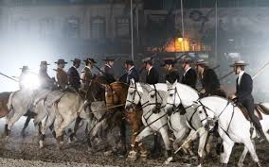
Laws and Cultural Practices in Each Country

Slide 92
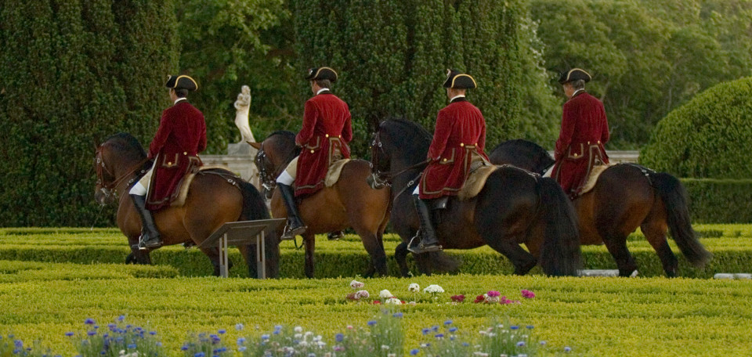
Laws and Cultural Practices in Each Country

Slide 93
Laws and Cultural Practices in Each Country
The Portuguese example of used or allowed clothes and equipment.
Working Equitation:
There are traditional costumes that are not official laws or regulations, but are respected as if they were.

Slide 94
Laws and Cultural Practices in Each Country
For example:
The use of helmet can only be a regulation in competitions (besides Working Equitation), as traditionally, we wear a traditional hat.

Slide 95
Laws and regulations
Thank you for your attention!
This work is licensed under a Creative Commons Attribution-ShareAlike 4.0 International License. The texts produced in the Extra Qualification by the partners of the SPINE project are freely accessible through open license.

